Slide 1
Topic: Percentages
EQ: How do I convert between fractions, decimals and percentages?

Slide 2
Mental Arithmetic Divide and multiply the following by 10.
 | × 10 | ÷ 10
40
120
34.1

Slide 3
Answers Mark your work
 | × 10 | ÷ 10
40 | 400 | 4
120 | 1200 | 12
34.1 | 341 | 3.41

Slide 4
Fractions, Percentages and Decimals
Equivalent fractions
What does equivalent mean?
Notes:
Ask pupils what equivalent means.
Equal to or the same as.
Many words that start with equ- have something to do with things being equal. Can you think of any?
Some examples include equilateral, equation, equidistant.
Equivalent= equal in value
Equivalent fractions: what is an example
There are some common percentages and their equaivalent decimal and fractions you should be familiar with:

Slide 5
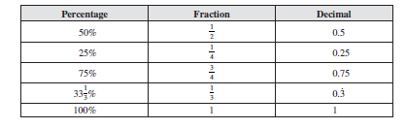
Common percentages and their equivalent fraction and decimal

Slide 6
Equivalent fractions
2
3
Notes:
Explain this set of equivalent fractions as in the previous slide.
2/3 = 4/6 = 6/9

Slide 7
Write down Three equivalent fractions of
4
5

Slide 8
Find 10 % of a quantity
10 % of $40
10 % of $208
10 % of $67.4

Slide 9
0.50
⁵⁰/₁₀₀
50%

Slide 10
0.25
²⁵/₁₀₀
¼
25%

Slide 11
0.75
⁷⁵/₁₀₀
¾
75%

Slide 12
0.18
¹⁸/₁₀₀
18%

Slide 13
0.04
⁴/₁₀₀
4%

Slide 14
Fractions, Decimals and Percentages
Fraction
0
1
Decimal
0
0.1
0.2
0.3
0.4
0.5
0.6
0.7
0.8
0.9
1
Percentage
0%
10%
20%
30%
40%
50%
60%
70%
80%
90%
100%
Just different ways of saying the same thing.

Slide 15
Answers to the matching activity
10% | 0.1 | 10/100
40% | 0.4 | 40/100
70% | 0.7 | 70/100
100% | 1 | 100/100
33 % | 0.33 | 33/100
67% | 0.67 | 67/100

Slide 16
1. What is equivalent to:
1
1
2
2
1.2
50%
20%

Slide 17
2. What is equivalent to:
1
1
10
10
2
0.01
10%
5

Slide 18
3. What is equivalent to:
0.2
0.2
2
2
2%
10
100

Slide 19
8. What is equivalent to:
1
1
5
5
0.5
20%
5%

Slide 20
9. What is equivalent to:
0.06
0.06
6
6%
60%
10

Slide 21
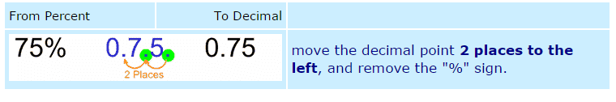
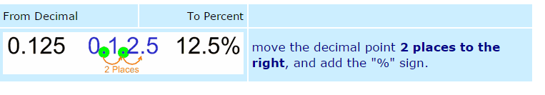
Converting between percentages, decimals and fractions
Percent to decimal
Decimal to percent
This is an overview! If you need more time and detail to revise this concept, this link may help you:
https://www.mathsisfun.com/decimal-fraction-percentage.html

Slide 22
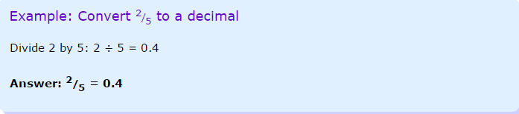
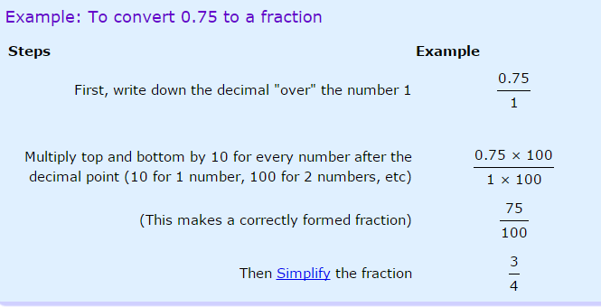
Fraction to decimal
Decimal to fraction

Slide 23
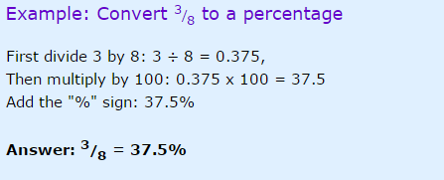
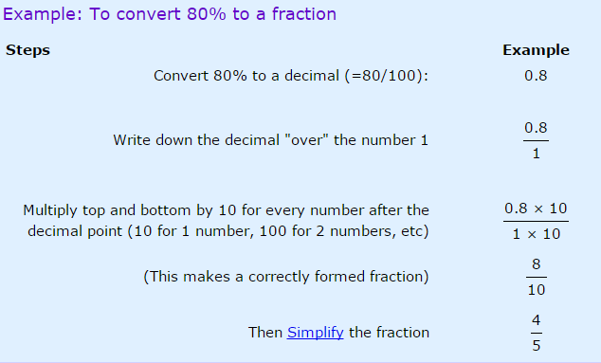
Fraction to percent
Percent to fraction

Slide 24
